Slide 1


Enhancing Stock Price Forecasting with Ensemble XGBoost and Temporal Similarity Search
Project by:
Ruben Sasson
Gil Biton
Notes:
Explain that this project combines machine learning with temporal similarity analysis to improve stock price prediction
.Mention that the approach builds upon Sidi’s framework and addresses its limitations.

Slide 2
Literature Survey – Abstract & Introduction
Motivation
Stock price forecasting is vital for investors and analysts
Traditional statistical models struggle with volatility and nonlinearities
ML methods like XGBoost are promising but can overlook rare events or deeper sequence dynamics
Paper’s Objective
Proposes a method to detect and integrate sequence patterns (via DTW) alongside ML predictions
Leverages similar stocks (via co-integration) to expand the training context
Core Focus
Enhanced stock prediction approach combining:
Machine Learning (XGBoost)
Time Series Similarity (DTW)
Co-integration & Symbolic Representations (SAX)
Addresses limitations in ML models (rare-event handling, forgetting sequential patterns)
Key Outcome
A hybrid model that integrates local sequence patterns (DTW) with global ML signals, showing improved accuracy (~53.19%) over single-stock or purely ML-based methods
Literature Review
Methods
Research Questions
Experimental Plan
Results
Conclusions
Future Work
Notes:
Highlight the importance of machine learning in stock forecasting.
Explain Zhang et al.’s findings (2019) about XGBoost outperforming traditional regression models due to scalability and ability to handle non-linear relationships.
Discuss the limitations of relying solely on single-stock data, such as the lack of broader market insights.
Emphasize that incorporating data from similar stocks can enrich the training dataset and improve accuracy.

Slide 3
Shortened Literature Survey – Previous Work in Stock Price Prediction
Traditional Statistical Methods
Early approaches (e.g., linear regression, ARIMA) often assumed stationarity and struggled with volatile, high-dimensional data.
Limited adaptability to sudden market shifts; reliance on single-stock historical data can reduce generalizability [1].
Shift to Machine Learning
Techniques like XGBoost efficiently capture nonlinear relationships in large datasets [11].
Research underscores the importance of integrating additional data sources (e.g., related stocks, macro variables) to enhance predictive performance [7].
Still, standard ML models may overlook rare events (abnormal market conditions) and can “forget” past patterns when trained incrementally [1].
Time-Series Similarity Approaches
Dynamic Time Warping (DTW): Enables flexible alignment of time series that may differ in tempo or shift [10].
Co-integration: Detects stable, long-term relationships, identifying stocks that share underlying economic factors [3,5].
Symbolic Aggregation (SAX): Reduces dimensionality by converting continuous signals into discrete symbolic sequences for efficient pattern detection [6].
Literature Review
Methods
Research Questions
Experimental Plan
Results
Conclusions
Future Work
Notes:
Highlight the importance of machine learning in stock forecasting.
Explain Zhang et al.’s findings (2019) about XGBoost outperforming traditional regression models due to scalability and ability to handle non-linear relationships.
Discuss the limitations of relying solely on single-stock data, such as the lack of broader market insights.
Emphasize that incorporating data from similar stocks can enrich the training dataset and improve accuracy.

Slide 4

Literature Survey: Our Hybrid Model and Key Contributions
Hybrid Integration of ML + Sequential Similarity
We propose a two-pronged framework: (1) an XGBoost classifier enhanced with multi-stock data via co-integration, and (2) a DTW-driven sequence detector.
Addressing Critical Gaps
Rare Event Sensitivity: Sequence-based detection helps identify sudden but impactful market shifts that pure ML models may miss.
Avoiding Pattern Forgetting: Integrating SAX and DTW preserves essential temporal patterns, providing historical context alongside predictive modeling [7].
Performance and Impact
Empirical results show improved accuracy over single-stock or single-method approaches—small but significant gains in a domain where incremental improvements can translate into large financial benefits.
The model balances computational feasibility with robustness, offering a scalable strategy for real-world trading and risk management.
Literature Review
Background
Research Questions
Experimental Plan
Results
Conclusions
Future Work
Notes:
Discuss early clustering methods for grouping financial time series based on behavior, such as Aghabozorgi & Teh's use of Euclidean distance.
Highlight the limitations of Euclidean distance in capturing temporal dependencies.
Explain DTW as a more robust method for aligning sequences with temporal variations and its effectiveness shown by Wang et al. (2012).
Introduce SAX as a computationally efficient alternative for reducing dimensionality while retaining key patterns, but note its struggle with subtle local variations.

Slide 5
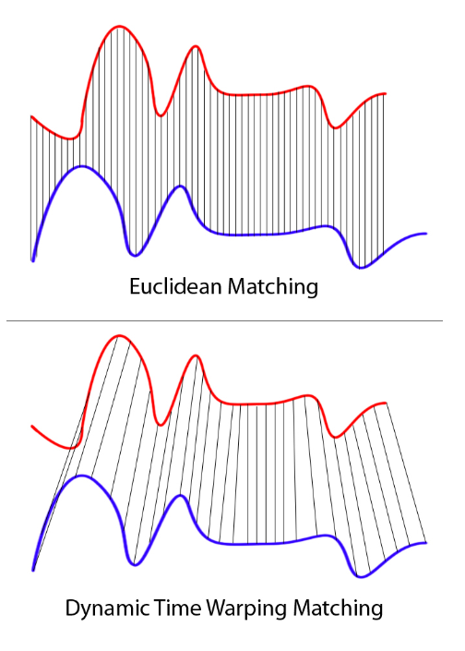
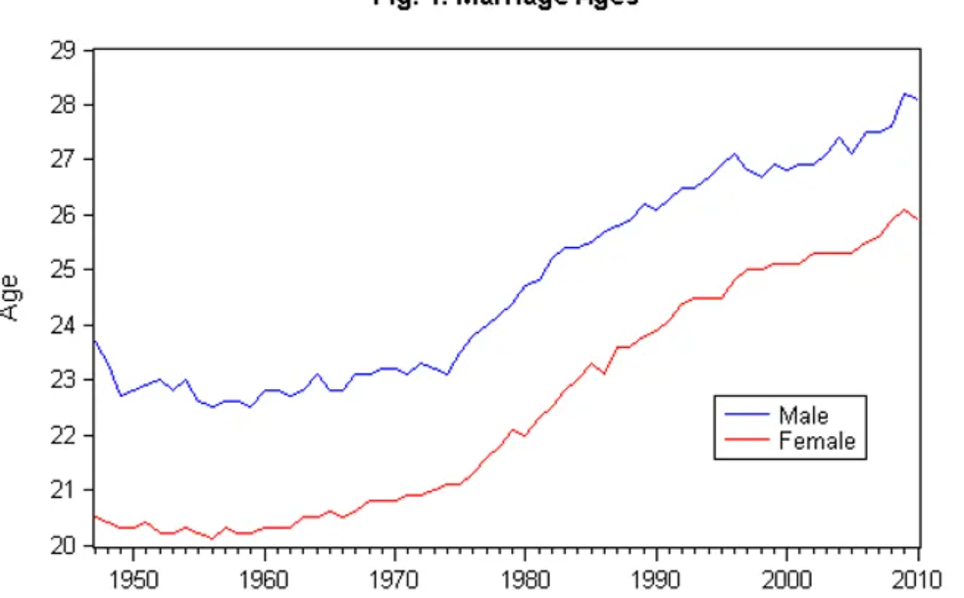
Methods -Background
Time-Series Similarity
Dynamic Time Warping (DTW):
Nonlinear alignment for short-term pattern matching. Allows comparing differently “paced” sequences, critical when stocks show similar trends but out of phase
2. Symbolic Aggregate Approximation (SAX):
Converts continuous time-series segments into discrete symbols
Purpose: Reduce high-dimensional data while preserving essential “shape” of price changes
Makes it more efficient for pattern matching with time series similarity methods
3. Co Integration :
a condition where two (or more) non-stationary time series share a stable long-term equilibrium relationship, even though each individual series may trend over time.
Using EG test to determine if 2 series are co-integrated or not.
Apple
c
b
a
t
t+1
tn
Literature Review
Background
Research Questions
Experimental Plan
Results
Conclusions
Future Work

Slide 6
Research Question
Question 1: Can we improve XGBoost price prediction using similar stocks data?
Question 2: Can we enhance price prediction accuracy by combining XGBoost and a sequential similarity based model into a hybrid algorithm?
Underlying Issues:
Single-Asset Focus: Reliance on one stock’s history may overlook broader market signals.
Nonlinear & Volatile Dynamics: Traditional models often fail to handle abrupt shifts or rare events.
Sequential Pattern Forgetting: Standard rolling-window ML can lose track of longer-term dependencies
Aim: Evaluate whether combining co-integrated stocks’ data and a sequence-focused approach (DTW) can produce consistently higher predictive accuracy, particularly for short-term direction forecasts.
Literature Review
Methods
Research Question
Experimental Plan
Results
Conclusions
Future Work

Slide 7

Experimental Setup – Data & Feature Engineering
Data Source - 5 Years of Daily S&P 500 Data from Yahoo Finance
AAPL serves as the primary target for forecasting. Later, additional stocks are integrated (Section 4.3) using co-integration analysis
Feature Extraction :
OHLC Indicators
Open, High, Low, Close values are base features primarily used to derive PROC and other technical measures
2. PROC (Price Rate of Change) –
3. Technical Indicators
MACD – different between 26days and 12days Moving averages. Used to identify trend reversals and strength.
RSI - Measures the magnitude of recent price changes
BB – simple moving average + k std
Literature Review
Methods
Research Question
Experimental Plan
Results
Conclusions
Future Work

Slide 8
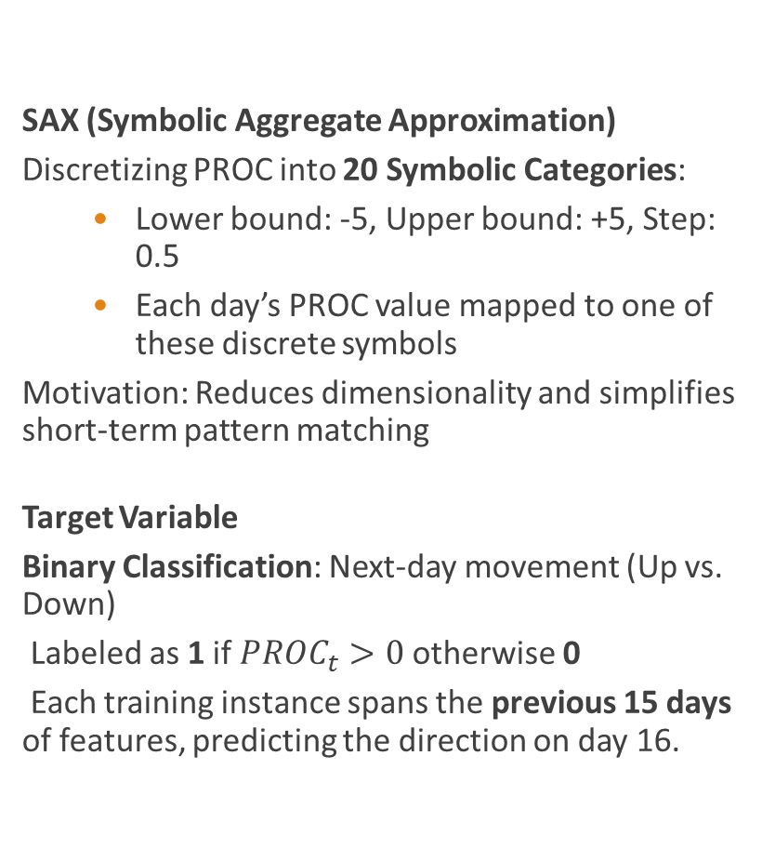
Experimental Setup – Data & Feature Engineering
SAX (Symbolic Aggregate Approximation)
Discretizing PROC into 20 Symbolic Categories:
Lower bound: -5, Upper bound: +5, Step: 0.5
Each day’s PROC value mapped to one of these discrete symbols
Motivation: Reduces dimensionality and simplifies short-term pattern matching
Target Variable
Binary Classification: Next-day movement (Up vs. Down)
Labeled as 1 if $PROC_{t}>0$otherwise 0
Each training instance spans the previous 15 days of features, predicting the direction on day 16.
Literature Review
Methods
Experimental Plan
Results
Conclusions
Future Work
Research Question

Slide 9
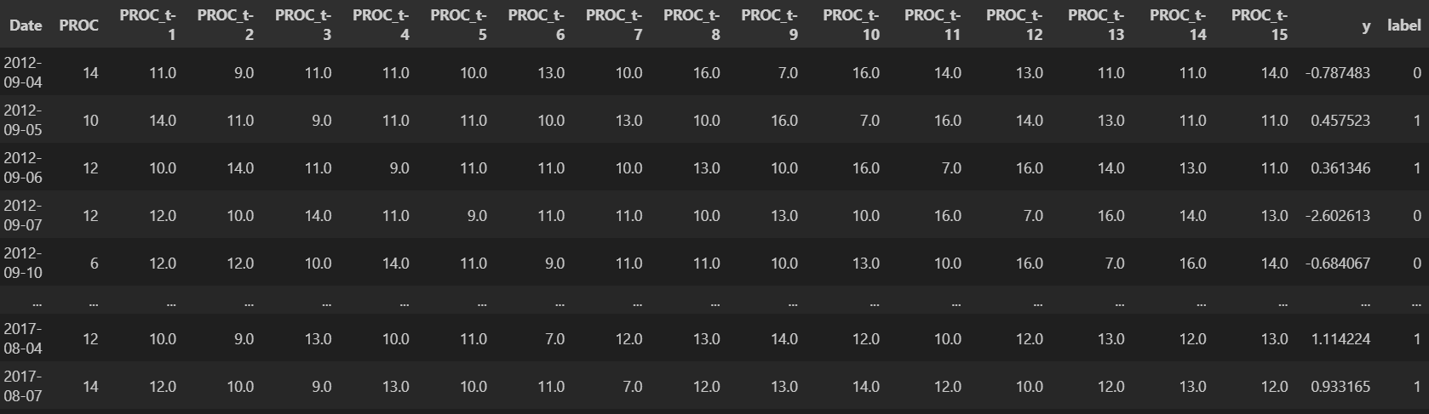

Slide 10
Experiment 1– Baseline Classifier
Baseline Model: XGBoost Classifier
Training
Input: 15-day window of AAPL’s PROC (and filtered indicators)
Target: Next-day direction (binary)
Hyperparameter Tuning
3-fold cross-validation, optimizing learning rate, max depth, etc.
Baseline Accuracy: ~50.4%
slightly exceed random guessing (0.5)
Literature Review
Methods
Research Question
Experimental Plan
Results
Conclusions
Future Work

Slide 11
Experiment 2– Incorporating Similar Stocks
Co-integration for Stock Selection
Apply Engle-Granger test to each S&P 500 stock vs. AAPL
Sort by p-value; pick top 5 co-integrated stocks
Expanded Training
Augment dataset with these similar stocks PROC windows
Provide broader market context to the XGBoost model
By incorporating data from similar stocks, we increased the training set’s diversity, modestly improving mean accuracy to 51.96%.
Literature Review
Methods
Research Question
Experimental Plan
Results
Conclusions
Future Work

Slide 12
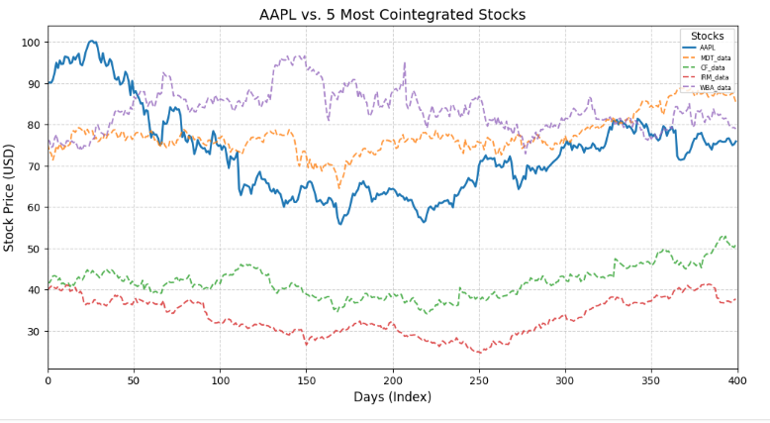
Cointegrated Stocks

Slide 13

Experiment 3– Hybrid Prediction – XGBoost + Sequence Similarity
Experiment Definitions :
1) Identify k most similar sequences by DTW
Use DTW to calculate the similarity between sequences in augmented dataset (with similar stocks)
2) Extract their next-day labels (0 = price decrease, 1 = price increase).
Predict by Majority-Vote these labels:
If the average of next-day labels ≥ 0.5, predict “Up” (1)
Else, predict “Down” (0)
3) Make a prediction with XGBoost with similar stocks data
4) Combine output predictions :
Literature Review
Methods
Research Question
Experimental Plan
Results
Conclusions
Future Work

Slide 14
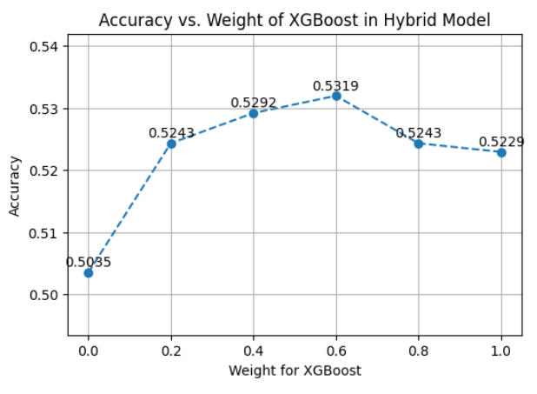
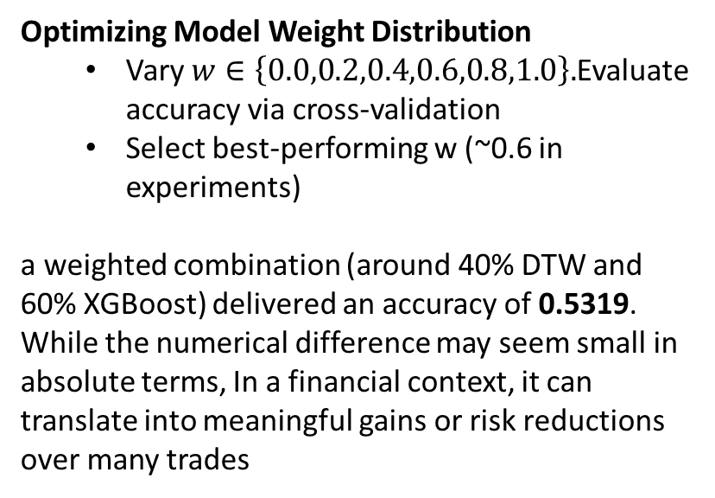
Experiment 3– Hybrid Prediction – XGBoost + Sequence Similarity
Optimizing Model Weight Distribution
Vary $w∈\left\{0.0,0.2,0.4,0.6,0.8,1.0\right\}.$Evaluate accuracy via cross-validation
Select best-performing w (~0.6 in experiments)
a weighted combination (around 40% DTW and 60% XGBoost) delivered an accuracy of 0.5319. While the numerical difference may seem small in absolute terms, In a financial context, it can translate into meaningful gains or risk reductions over many trades
Literature Review
Methods
Research Question
Experimental Plan
Results
Conclusions
Future Work

Slide 15

Results
Experiment 1: Baseline Classifier
Single-Stock XGBoost → ~50.4% accuracy
Experiment 2: Incorporating Similar Stocks
Multi-Stock XGBoost → ~51.96% accuracy
Demonstrates value of co-integrated data
Experiment 3: Sequence-Based Model and Hybrid Approach
DTW Alone → ~52% accuracy
Hybrid (XGBoost + DTW) → ~53.19% accuracy
Incremental gains (1–3%) matter in trading
Literature Review
Methods
Research Question
Experimental Plan
Results
Conclusions
Future Work

Slide 16
Discussion & Conclusions
Insights
Co-integration effectively expands the training set with fundamentally related stocks
DTW helps detect short-lived patterns or volatility spikes
Small accuracy improvements can yield substantial financial benefit
Overall Conclusion
Hybrid approach outperforms standalone ML or sequence-only methods
This Research Demonstrates the synergy between global ML features and local pattern alignment
Literature Review
Methods
Research Question
Experimental Plan
Results
Conclusions
Future Work

Slide 17
Future Work
Meta-Ensemble Approaches
Incorporate deep learning (RNN, Transformer) or additional boosting algorithms
Longer-Horizon Forecasting
Current model focuses on next-day predictions; expand to weekly or monthly horizons
Additional Data Sources
Macro indicators, sentiment analysis, or sector-specific events for improved context
Adaptive Weighting
Dynamically update weight for XGBoost vs. DTW in response to changing market conditions
Literature Review
Methods
Research Question
Experimental Plan
Results
Conclusions
Future Work

Slide 18
Thanks For Listening !

